Slide 1





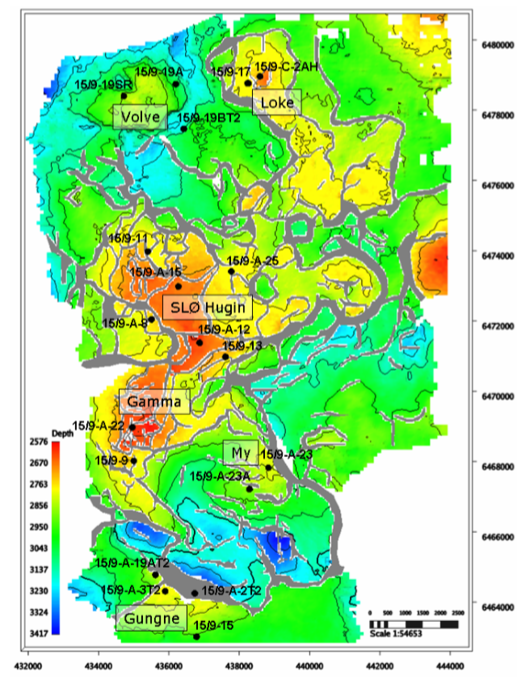
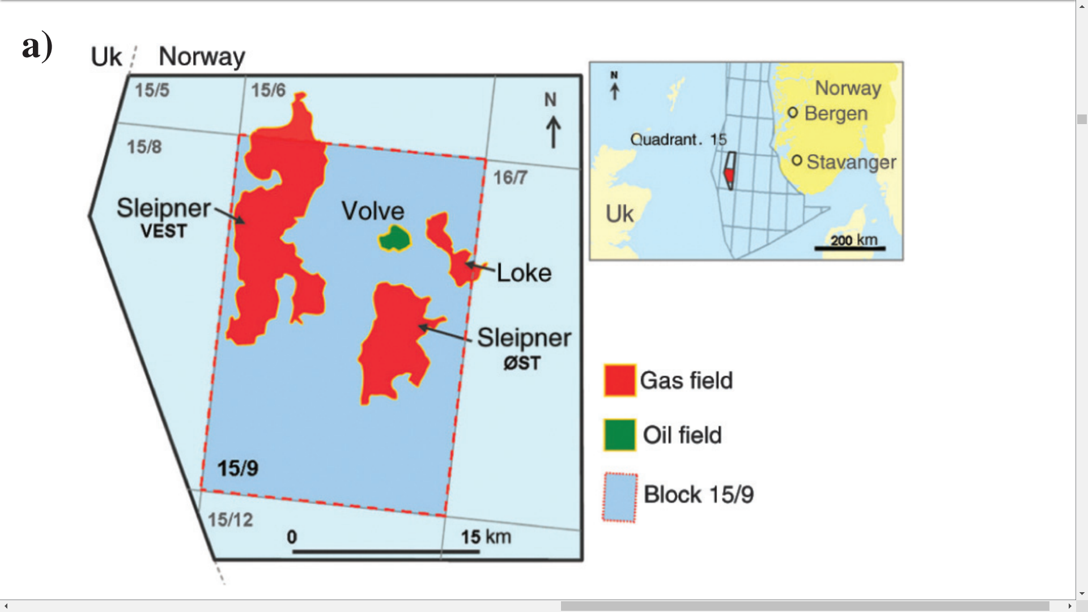
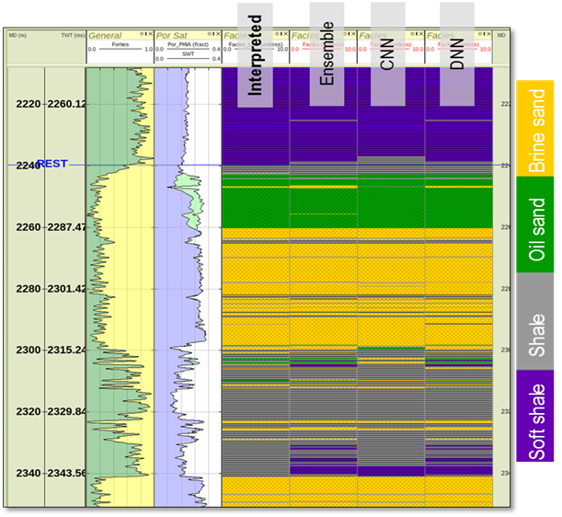

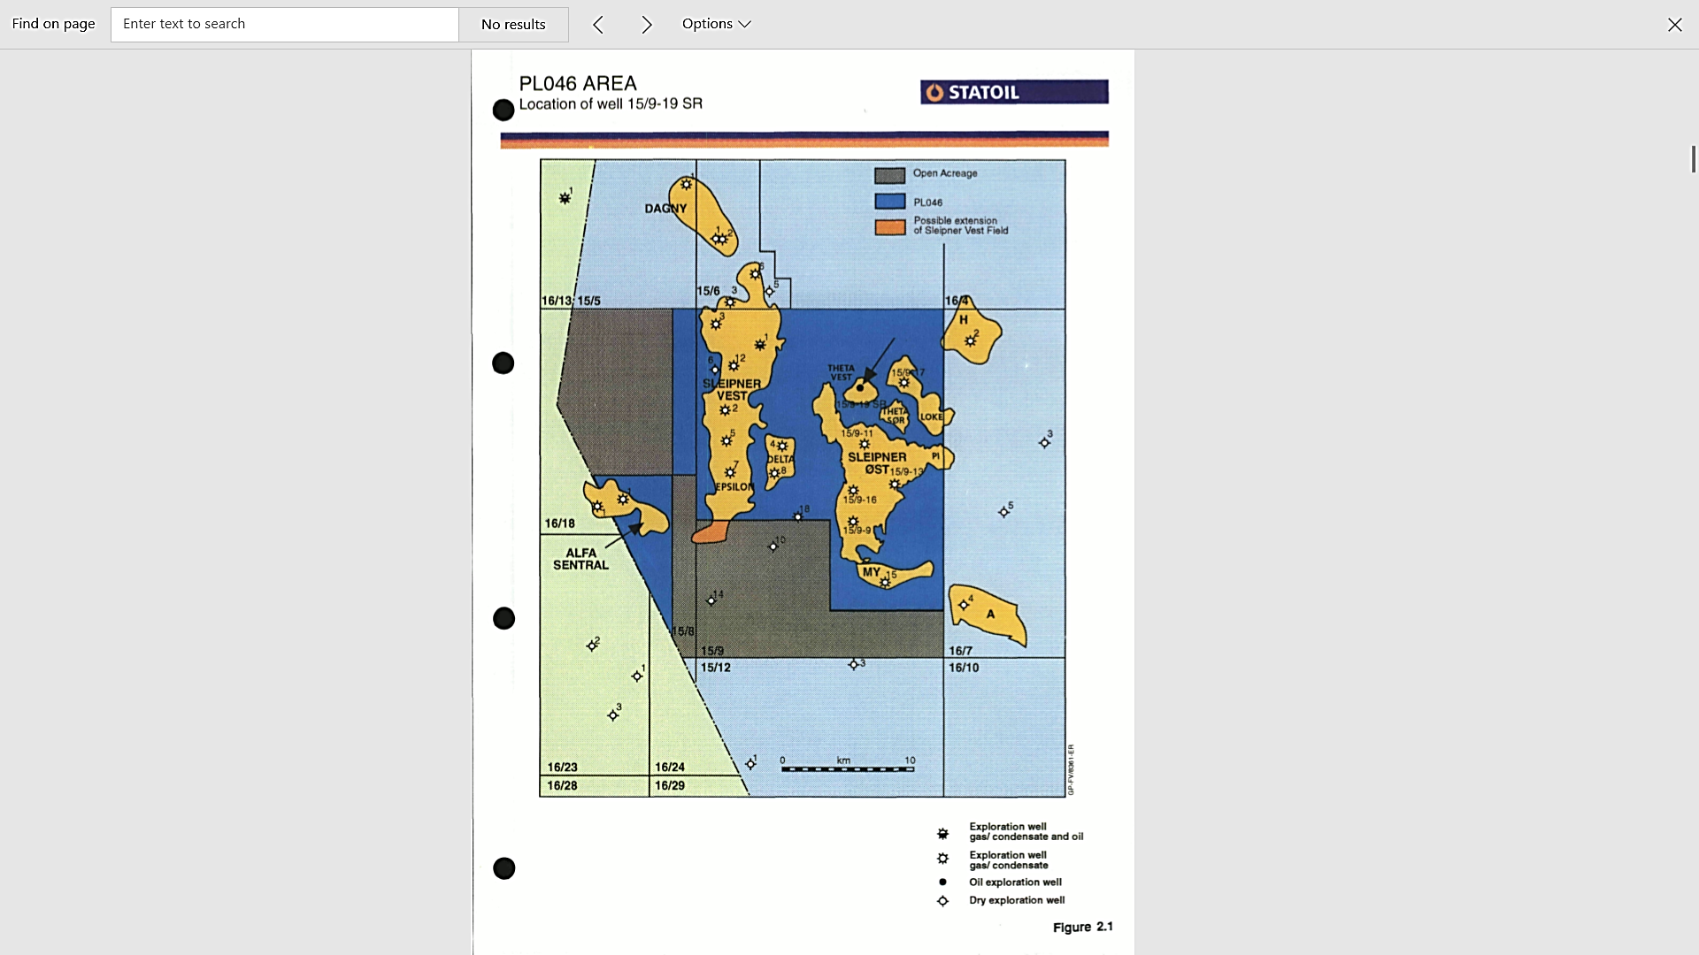
Litho-Facies Classifications Using Unsupervised Machine Learning
196 x 240 Pixel Photo
Nadima Dwihusna
Objective
Available Data
Proposed Workflow
Perform litho-facies classification at Norwegian North Sea Field
Well based
Seismic based
Production
Well, Completion design
Seismic
Well logs (~850)
Core logs
Geology, Stratigraphy
Static, dynamic models
Each well has:
Gamma Ray
Neutron Porosity
Bulk Density
Lithology
Caliper
Bit Size, Speed
Understand Objective and Problem
.
Get the Data
Analyze / visualize the data
Compare Unsupervised ML Methods
K-Nearest Neighbors
Deep learning based e.g. Restricted Boltzmann, Deep Belief Network, etc
Prepare Data for ML Algorithm
Results
Select Model and Perform Training
Map View of Wells
Improve litho-facies classification and decrease computation time
QC and Fine-Tune the Model
Present, Launch, Monitor
Future Work
Compare results between different Machine Learning methods
Further develop code to determine compaction and depth trends per facies by analyzing larger scale heterogeneous datasets
Introduce seismic data into workflow
Acknowledgement
Figure 1. Top Hugin Formation Structure Map in Block 15/9 of Sleipner Ost and Volve Field
Figure 2. Example of expected result using 3 different
ML methods compare against interpreted
Thank you to Ehsan Naeini from Ikon Science for you advice on this project.
Notes:
1. Objective
Norwegian North Sea Field
Unsupervised ML
KNN
Deep learning
Restricted Boltzmann
Deep belief network
2. Map View of Wells
Location of wells in block 15/9 of Sleipner Ost and Volve Field
3. Available Data
List of Data
Production
Well design
Completion design
Seismic and well logs
Geology
stratigraphy
Static and dynamic models
Each well has
Gamma ray
Neutron porosity
Bulk density
Lithology
Caliper
Bit size and speed
4. Proposed Workflow
Understand objective and problem
Get the data: analyze / visualize the data
Prepare data for ML Algorithm
Select Model and Perform Training
QC and Fine-Tune the Model
Present, Launch, Monitor
5. Results
Improve litho-facies classification and fasten computation time by ML
6. Future Work
Compare results between different Machine Learning methods
Further develop code to determine compaction and depth trends per facies by analyzing larger scale heterogeneous datasets
Application to seismic data
7. Acknowledgement
Thank you Ehsan, Ikon Science
What is tension?
What is unsupervised ml be able to exmplain knn etc
Proposed workflow explain each
Why unsupervised ML when you have labeling
What to say in image section – mention in Ehsan.
Know the difference between ML Methods

